Slide 1
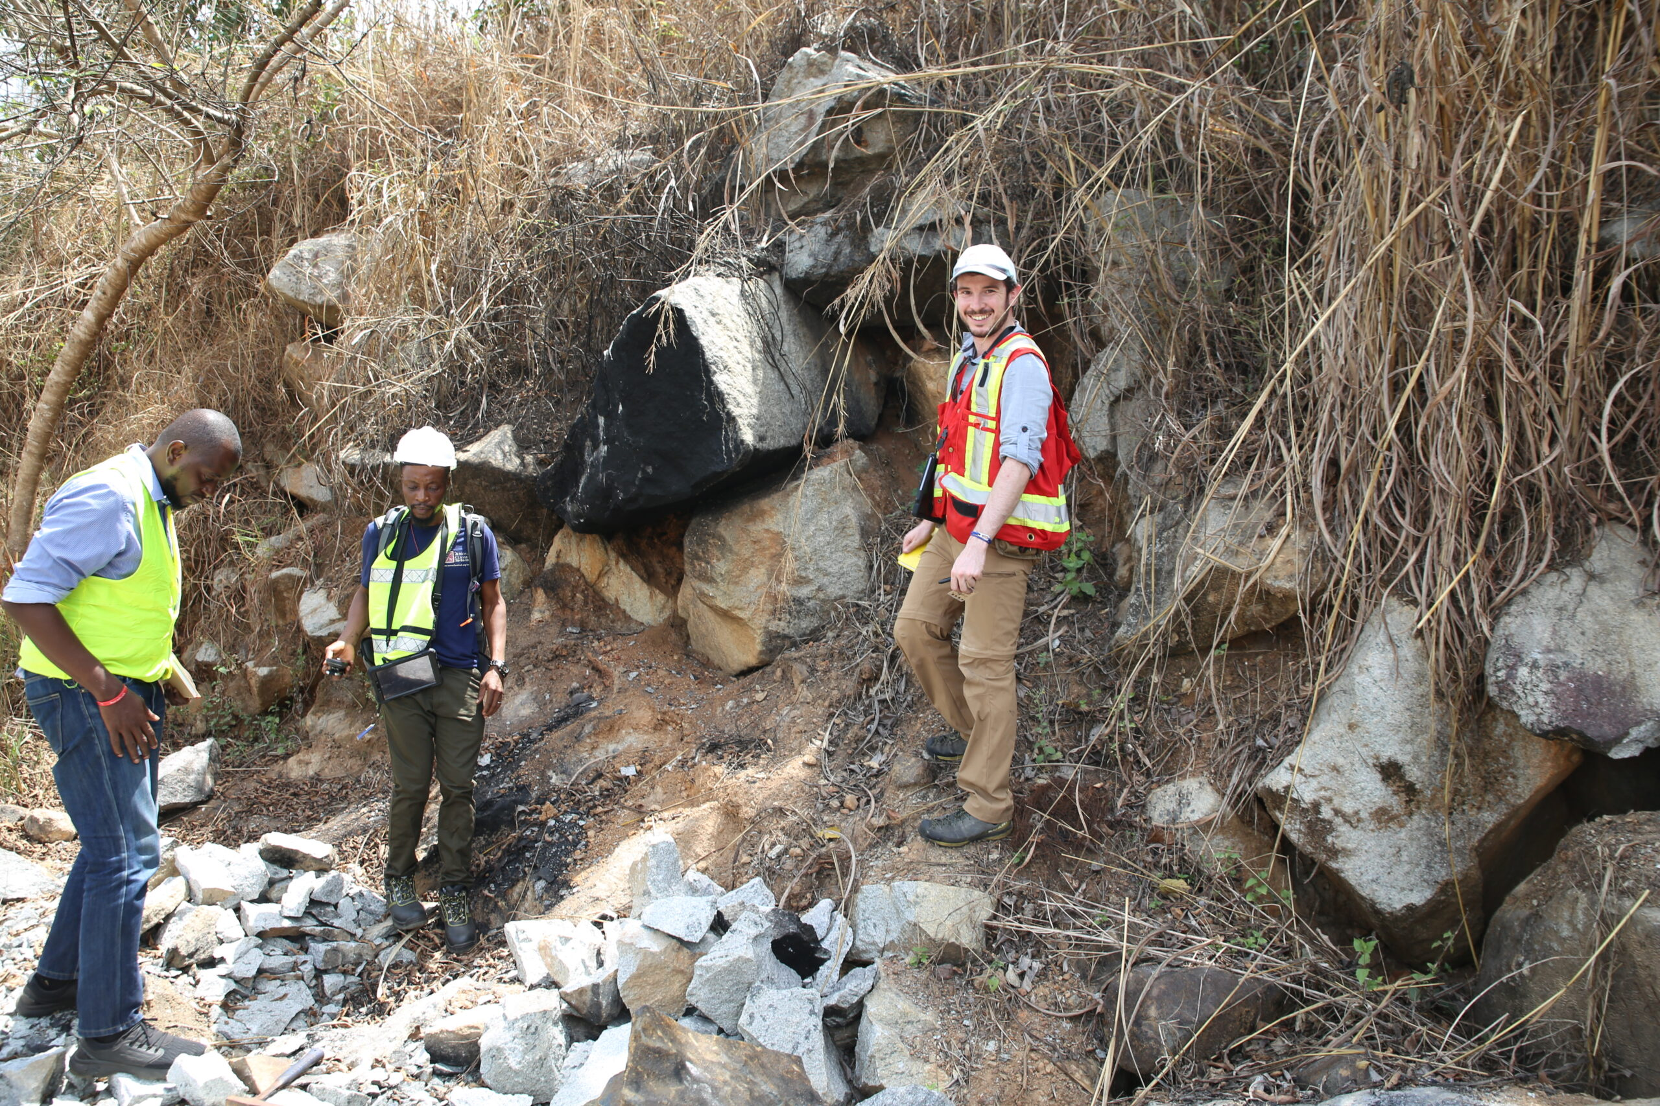
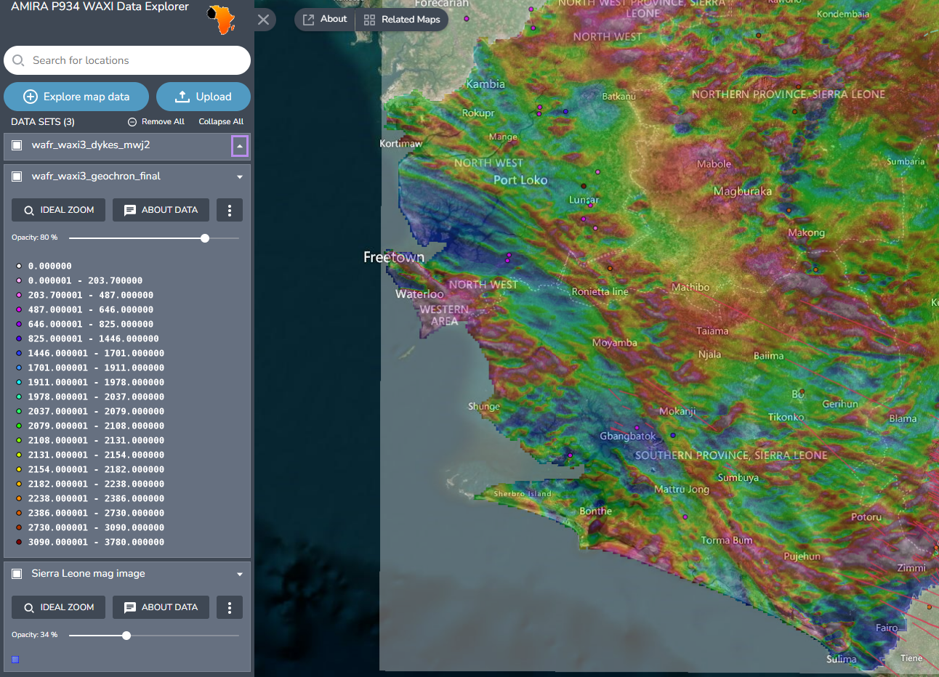






Delivering data using GeoServer with TerriaMap and custom systems
Mark Jessell, Guillaume de Boyer, Lu Li, Julien Perret, Weronika Gorczyk
Wednesday 5th July 2023

Slide 2

Industry + Govt funded research in tectonics and metallogenesis in West Africa since 2006:
~900 GB GIS
~350 vector and raster layers, of which 170 are available via Geoserver
https://waxi4.org/
Industry + Govt funded research in tectonics and metallogenesis in NE South America since 2018:
~700 GB GIS
~250 vector and raster layers, of which 150 are available via Geoserver
https://saxiproject.org/
Not-for-profit training & scholarships in the Earth Sciences in Africa since 2020 continuing work from WAXI Capacity Building program started in 2006:
~150 Hons/MSc/PhD/Postdoc Projects >70% African
~30 training courses, all in country (Covid-excepted!)
https://agate-project.org/

Slide 3
Data Scope
4 Geographic Scopes:
Country Level:
Burkina Faso, Mali, Liberia, Mauritania, Senegal, Ghana, Guinea, Cote d’Ivoire, Togo, Niger, Sierra Leone
West Africa
Africa
Global
5 Thematic Scopes:
Geography:
gazeteer, roads, rivers…
Geology:
maps, point observations, 3D models…
Geophysics:
survey extents, line data, interpolated grids, inversions…
Minerals:
mineral deposit databases…
Tectonics:
plate boundaries, subduction zone models, paleomagnetic data…

Slide 4
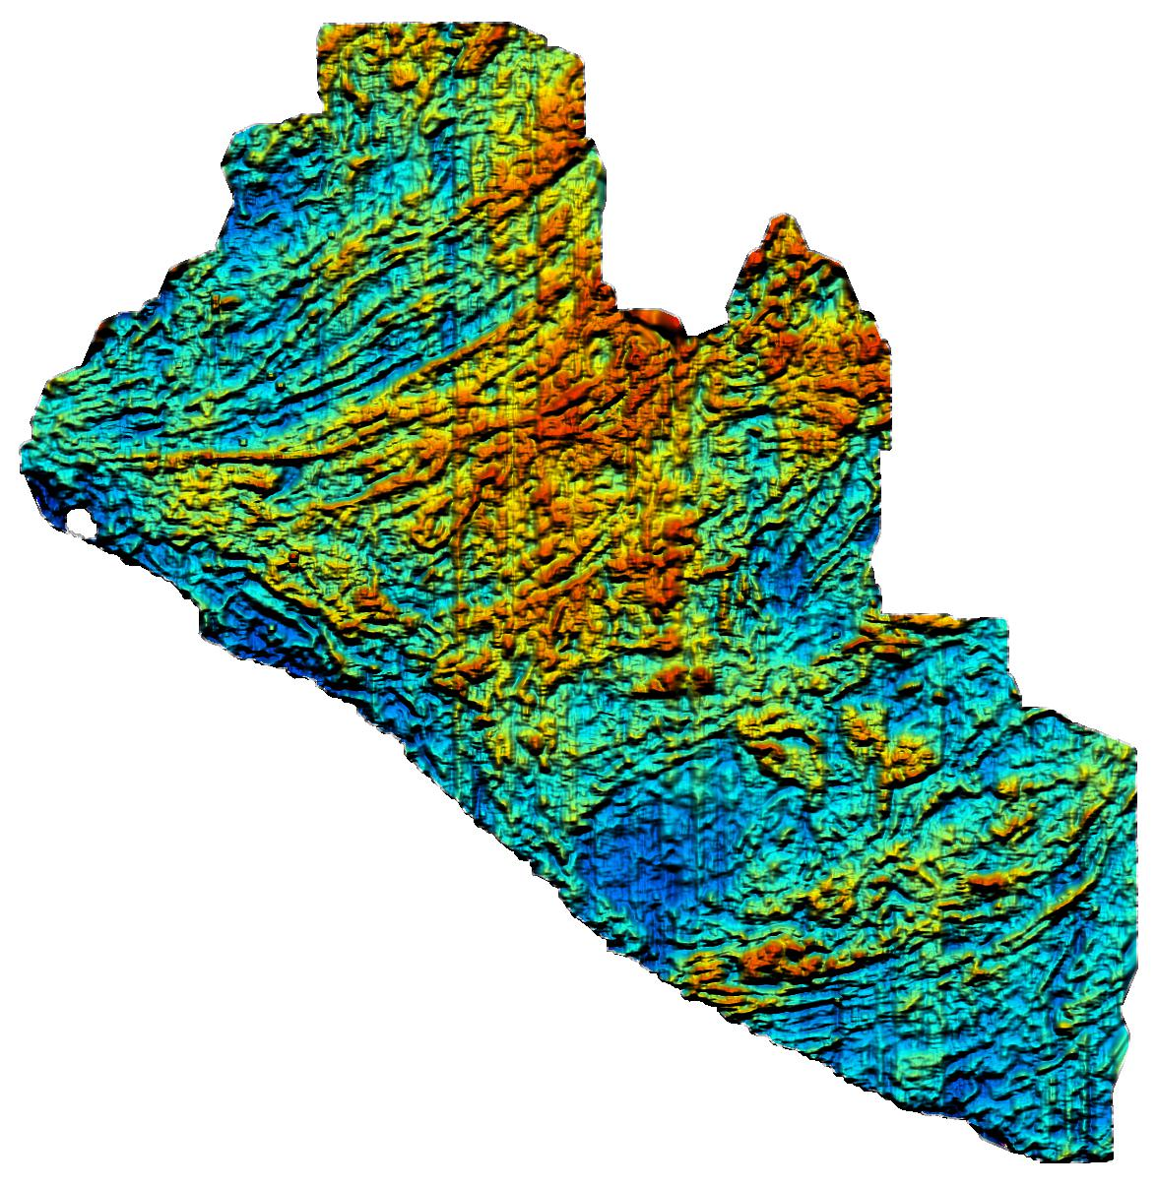
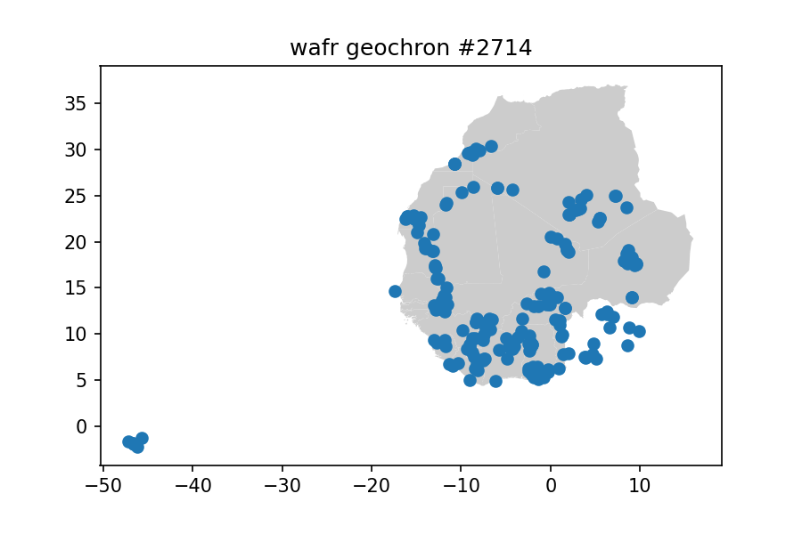
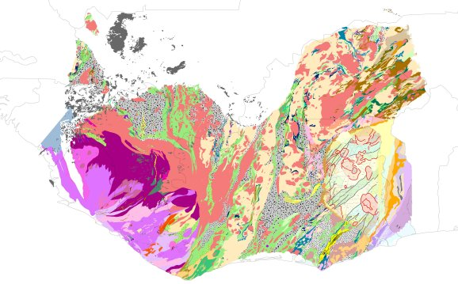
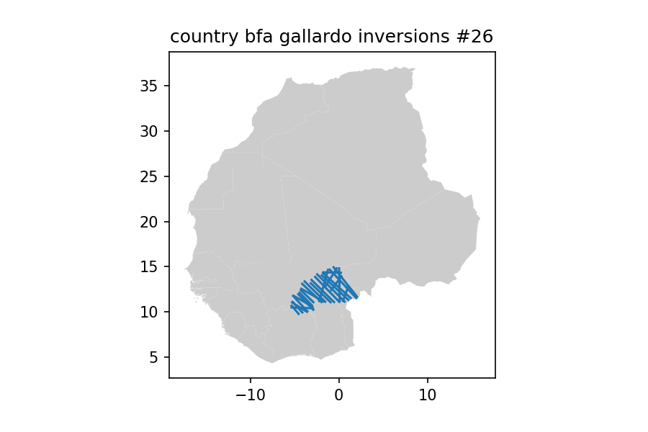
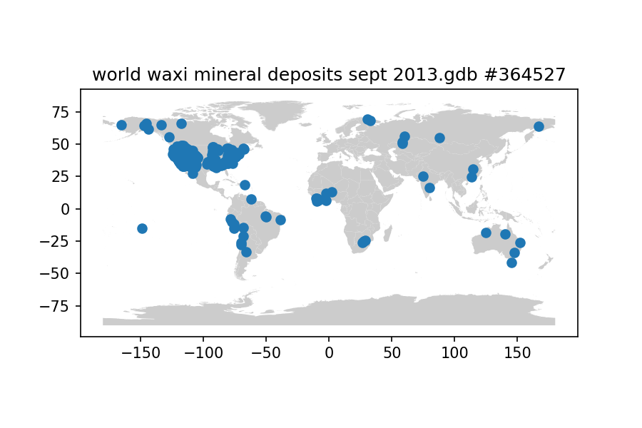
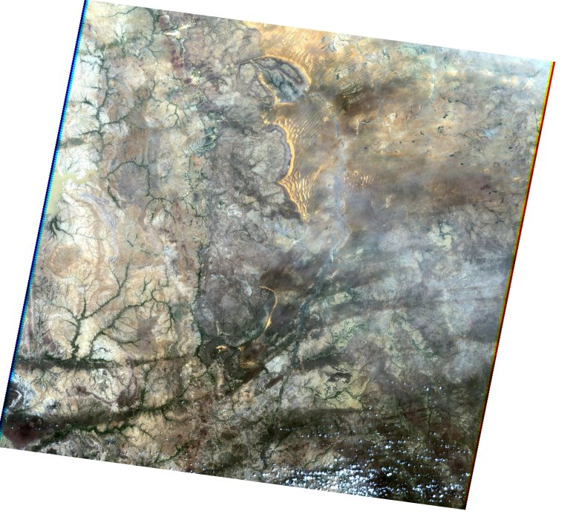
Types of layers (mostly vector)
Magnetic Surveys
Original/Compiled Geochronological Data
Original/Compiled Geological Maps
Aster Scenes
Gravity/Magnetic Inversions
Mineral deposit Databases

Slide 5


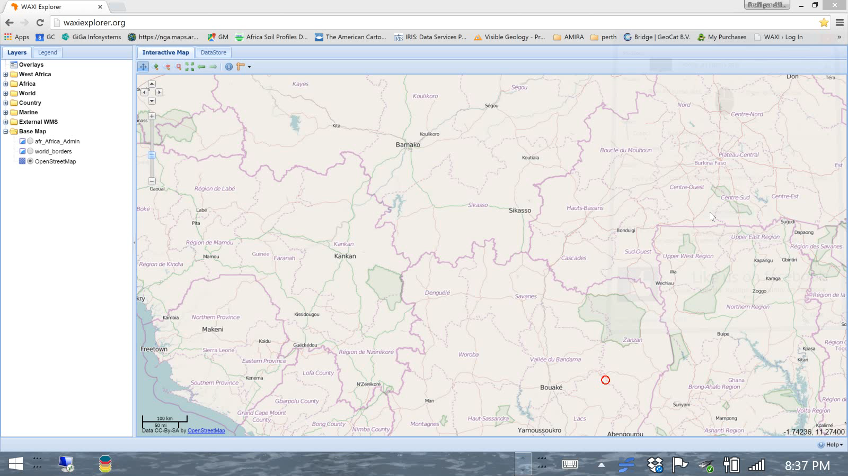
The West African GIS started in 2007 as a gaps analysis
By 2009 the data had been vaguely organised in to a GIS (ArcMap & MapInfo)
By 2011 our first Geoserver Instance was up and running using a custom Javascript/Open Layers client-side tool (Guillaume de Boyer’s Master’s Project at Uni Mirail)
Random Stuff on My Hard Disk
PostGIS Database
GeoServer
JavaScript Client

Slide 6



In 2022, someone turned off the virtual computer in Toulouse…
https://github.com/TerriaJS/TerriaMap
Apache-2.0 license
https://github.com/AuScope/AuScope-Portal
LGPL-3.0, GPL-3.0 licenses found
https://github.com/qgis
GPL-2.0 license

Slide 7
Your computer
Amazon or Local Server
Anyone’s computer
QGIS with GeoCat plugin
Data server
Geoserver
TerriaMap in browser
TypeScript & ES2020+ JavaScript,
Upload files using
geocat bridge QGIS plugin
Store of GIS & non-GIS info (pdfs etc.)
Store styles, publish PostGIS layers with styles, directly upload geotiffs
Random Stuff on My Hard Disk
PostGIS Database
TerriaMap Server
NodeJS
User interaction and display of layers with styles
Serve TerriaMap functionality
TerriaMap config Files:
TerriaMap/wwwroot/init/simple.json
TerriaMap/wwwroot/config.json
config.json best generated from python script based on layers published by geoserver in directory config_generator run :
python3 config_generator_https.py

Slide 8
TerriaMap features
Nested catalogue of layers
Supports GeoJSON, KML, CSV (point and region-mapped), GPX, GeoRSS, CZML and zipped shapefile file types natively.
Supports WMS, WFS, WMTS, Esri MapServer, Esri FeatureServer, Bing Maps, Carto Maps, Cesium Ion Imagery, OpenStreetMap-style raster tiles, Mapbox, SDMX, 3D Tiles and GTFS and Sensor Observation Service item types.
Supports querying WMS, WFS, Esri MapServer, CSW, CKAN, Socrata, OpenDataSoft and SDMX services for groups of items.
3D globe (Cesium) or 2D mode (Leaflet). 3D objects supported in CZML format.
Time dimensions supported for CSV, CZML, WMS.
Drag-and-drop files from your desktop to the browser
Users can generate a reusable URL link of their current map view, to quickly share mashups of web-hosted data.

Slide 9
TerriaMap Configuration
TerriaMap config Files:
TerriaMap/wwwroot/init/simple.json (Data & Metadata control)
TerriaMap/wwwroot/config.json (Some interface control)
config.json best generated from python script
config_generator_https.py
This script scrapes the Geoserver instance for raster and vector layers and creates the appropriate file (so needs to be run each time Geoserver content is modified

Slide 10
simple.json
{
"type": "group",
"name": "Ghana_SW_Map Layers",
"members":
[
{
"type": "wms",
"name": "SW_GH",
"url": "https://www.waxiexplorer.org/geoserver/Ghana_SW_Map/wms",
"layers":"sw_gh",
"info":[
{
"name":"description",
"content":"SW_GH"
}
],
"dataUrls":
[
{
"url": "https://www.waxiexplorer.org/geoserver/Ghana_SW_Map/ows?service=WFS&version=1.0.0&request=GetFeature&typeName=Ghana_SW_Map:sw_gh&outputFormat=SHAPE-ZIP",
"title": "Download shapefile"
},
{
"url": "https://www.waxiexplorer.org/geoserver/Ghana_SW_Map/ows?service=WFS&version=1.0.0&request=GetFeature&typeName=Ghana_SW_Map:sw_gh&outputFormat=application/vnd.google-earth.kml+xml",
"title": "Download KML"
},
{
"url": "https://www.waxiexplorer.org/geoserver/Ghana_SW_Map/ows?&request=GetStyles&layers=Ghana_SW_Map:sw_gh&service=wms&version=1.1.1",
"title": "Download SLD Layer Style"
}
]
}
]
},

Slide 11
Want to play?
https://www.basins.zone/

